Slide 1
Resurrection Endowment Fund 2024
From the Endowment Fund Charter/Bylaws:
“The purpose of the Lutheran Church of the Resurrection Endowment Fund is to enhance the work of the church by establishing new ministries and stewardship opportunities in addition to and apart from the general operation of the church and outside of the church budget.”
Current Members:
Nikki D’Amour Mary Hauch
Steve Jacobson Gayle Wint

Slide 2
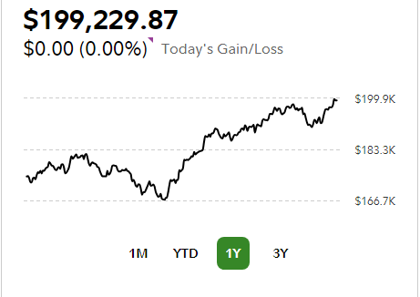
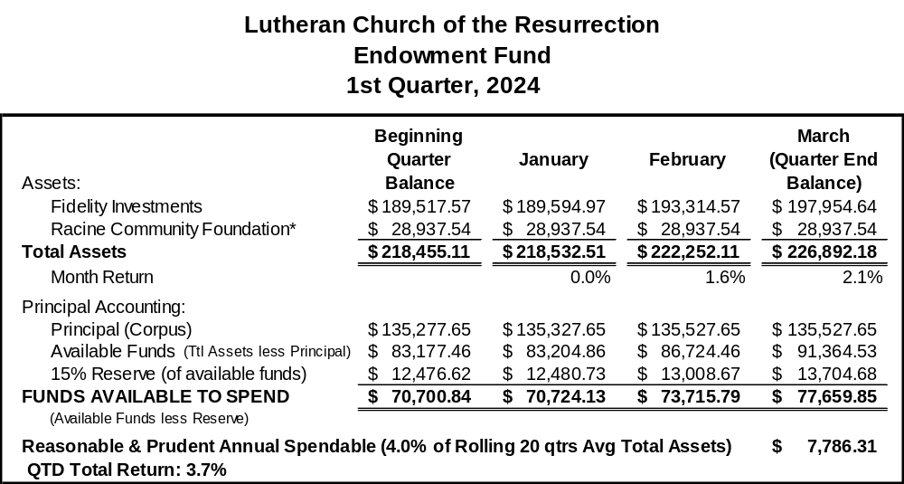
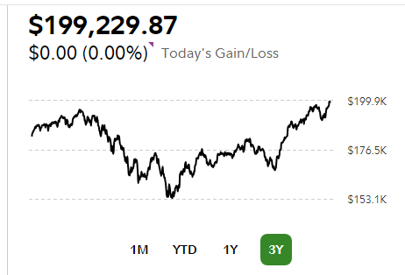
Resurrection Endowment Fund Performance
(Fidelity Portion only) as of May 20, 2024

Slide 3
Resurrection Endowment Fund 2024
Historical Returns (Fidelity Portion):
2019 YE Corpus was 129,283.65 (~$2,000 from Ken Fehl memorials in 2023)
Historical Grants (Money Disbursed):
2,000.00 Hospitality Center (2019)
1,000.00 Cops & Kids Reading
2,000.00 Bethany House of Caring
3,000.00 Tiny Homes-Milwaukee
1,000.00 Hopes Center of Racine
3,200.00 Tiny Home (Sunday School Matching)
1,750.00 LCR Video Equipment (2020)
2,000.00 Hospitality Center of Racine
1,000.00 Racine County Food Bank
1,000.00 Faithworks Food Pantry
1,000.00 Holy Communion Food Pantry

